Slide 1
MOBILE SALES REPORT
.

Slide 2
.
Introduction
Developed using Microsoft Power BI.
Analyzes mobile sales data through interactive dashboards. Displays key metrics such as Total Sales, Quantity Sold, and Transactions.
Provides city-wise, monthly, and product-wise sales analysis.
Includes interactive filters for better data exploration.
Helps businesses make informed, data-driven decisions.

Slide 3
OBJECTIVES
Analyze overall mobile sales performance.
Monitor key business metrics such as Total Sales, Quantity Sold, and Transactions.
Identify top-selling mobile brands and models.
Analyze sales trends across different months and cities.
Understand customer payment preferences.
Provide interactive filters for dynamic data analysis.
.

Slide 4
Dashboard Overview
KPI Cards : Display Total Sales, Total Quantity Sold, and Total Transactions.
Filters (Slicers) : Analyze data by Mobile Brand, Payment Method, and Month.
City-wise Sales Map : Visualizes sales performance across different cities.
Monthly Sales Trend : Shows changes in sales quantity over time.
Sales by Mobile Model : Compares the sales of different mobile models.
Payment Method Analysis : Displays the distribution of payment methods such as UPI, Cash, Debit Card, and Credit Card.
Sales by Day : Analyzes sales performance across different days of the week.
.

Slide 5
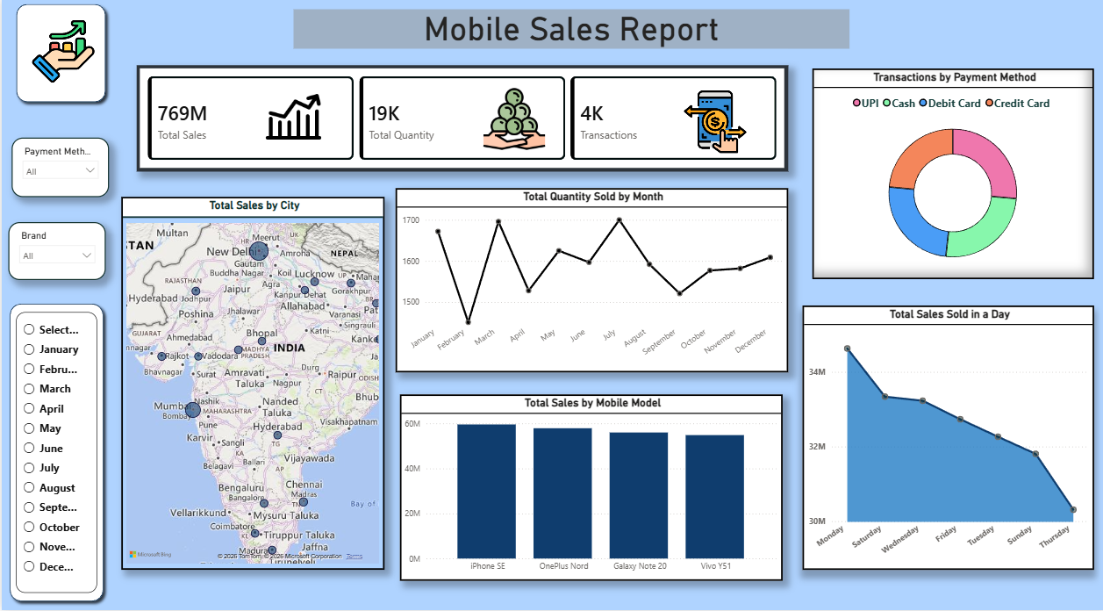

Slide 6
THANK you

